Slide 1
Tree

Slide 2
Tree
Tree is a hierarchical data structure which stores the information naturally in the form of hierarchy style.
Tree is one of the most powerful and advanced data structures.
A tree is a nonlinear data structure, compared to arrays, linked lists, stacks and queues which are linear data structures.
A tree is a collection of entities called nodes. Nodes are connected by edges. Each node contains a value or data, and it may or may not have a child node

Slide 3
Important Terms
Root is the topmost node of the tree
Edge is the link between two nodes
Child is a node that has a parent node
Parent is a node that has an edge to a child node
Leaf is a node that does not have a child node in the tree
Height is the length of the longest path to a leaf
Depth is the length of the path to its root
Siblings Nodes with the same parent are called Siblings.
Degree of Node Degree of a node represents a number of children of a node.
Visiting refers to checking the value of a node when control is on the node.

Slide 4
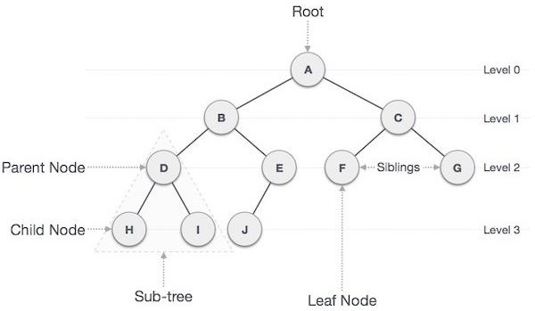
Traversing means passing through nodes in a specific order.
Level of a node represents the generation of a node. If the root node is at level 0, then its next child node is at level 1, its grandchild is at level 2, and so on.
Key represents a value of a node based on which a search operation is to be carried
out for a node.

Slide 5
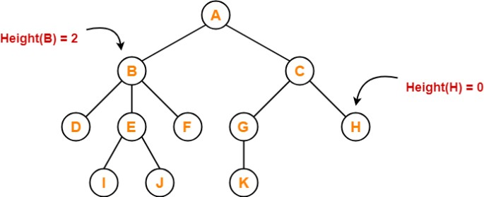
Height of tree
Height of node – The height of a node is the number of edges on the longest downward path
between that node and a leaf.
Height of tree –The height of a tree is the number of edges on the longest downward path between the root and a leaf.
Here, Height of node A = 3, B = 2, C = 2, D = 0, E = 1, F = 0, G = 1, H = 0, I = 0,J = 0, K = 0

Slide 6
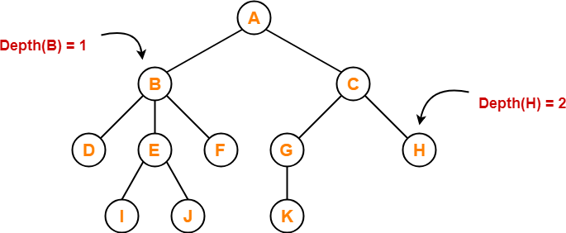
Depth of tree
Total number of edges from root node to a particular node is called as depth of that node.
Depth of a tree is the total number of edges from root node to a leaf node in the longest path.
Depth of the root node = 0
Here, Depth of node A = 0, B = 1, C = 1, D = 2, E = 2, F = 2, G = 2,
H = 2, I = 3, J = 3, K = 3

Slide 7
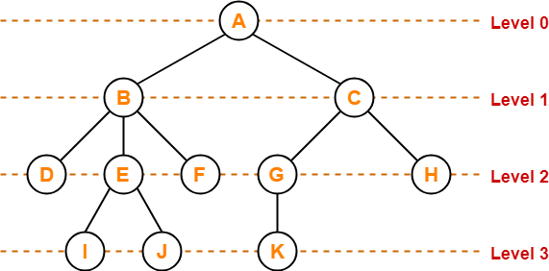
Level of tree
In a tree, each step from top to bottom is called as level of a tree.
The level of a node is defined by 1 + the number of connections between the node and the
root.

Slide 8
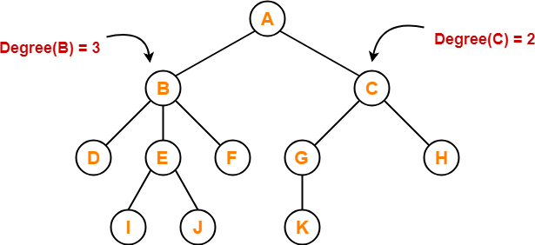
Degree
Degree of a node is the total number of children of that node.
Degree of a tree is the highest degree of a node among all the nodes in the tree.
Here,Degree of node A = 2, B = 3, C = 2, D
= 0, E = 2, F = 0, G = 1, H = 0, I = 0, J = 0,
K = 0

Slide 9
Applications of Trees
Binary Search Trees(BSTs) are used to quickly check whether an element is present in a set or not.
Heap is a kind of tree that is used for heap sort.
A modified version of a tree called Tries is used in modern routers to store routing information.
Most popular databases use B-trees and T-trees, which are variants of the tree structure we learned above to store their data
Compilers use a syntax tree to validate the syntax of every program you write.
Spanning Trees and shortest path trees are used in routers and bridges respectively in
computer networks

Slide 10
Binary Tree
Binary tree is a special type of data structure. In binary tree, every node can have a maximum of 2 children, which are known as Left child and Right Child.
A tree in which every node can have a maximum of two children is called Binary
Tree.
More tree terminology:
The depth of a node is the number of edges from the root to the node.
The height of a node is the number of edges from the node to the deepest leaf.
The height of a tree is a height of the root.

Slide 11
Types
A full binary tree/Strictly Binary Tree is a binary tree in which each node has exactly zero
or two children.
A complete binary tree is a binary tree, which is completely filled, with the possible exception of the bottom level, which is filled from left to right.
A Binary Tree is a complete Binary Tree if all levels are completely filled except possibly
the last level and the last level has all keys as left as possible.
The height h of a complete binary tree with N nodes is at most O (log N). We can easily prove this by counting nodes on each level, starting with the root, assuming that each level has the maximum number of nodes:
= O(log n)

Slide 12
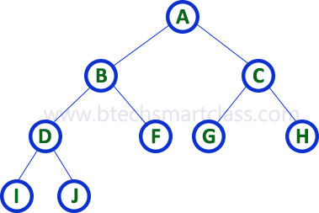
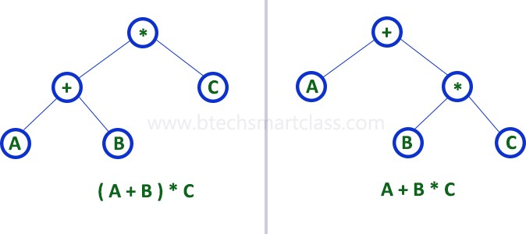
Strictly binary tree is also called as Full Binary Tree or Proper Binary Tree or 2-Tree
Example: Strictly binary tree data structure is used to represent mathematical expressions.

Slide 13
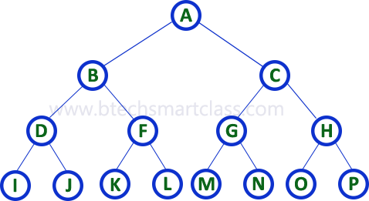
Complete binary tree is also called as Perfect Binary Tree
Extended Binary Tree: A binary tree can be converted into Full Binary tree by adding dummy nodes to existing nodes wherever required.
The full binary tree obtained by adding dummy nodes to a binary tree is called as Extended Binary Tree.

Slide 14
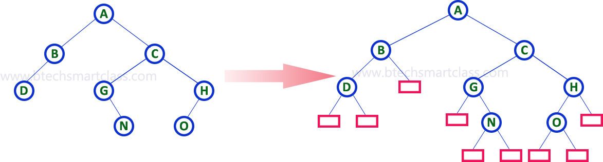

Slide 15
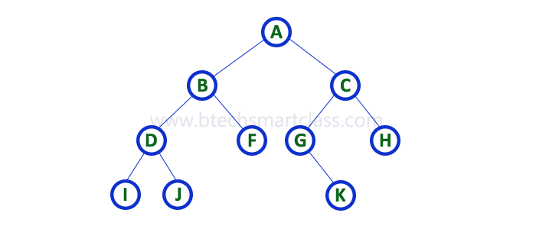
Binary Tree Representations
A binary tree data structure is represented using two methods.
Sequential representation using arrays
Linked List Representation
We use one-dimensional array (1-D Array) to represent a binary tree. Consider the above example of a binary tree and it is represented as follows

Slide 16

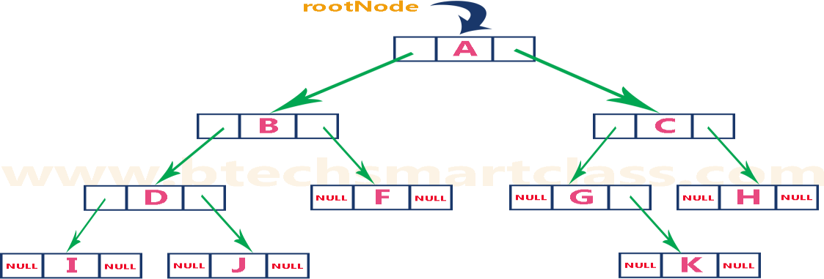
In a double linked list, every node consists of three fields. First field for storing left child address, second for storing actual data and third for storing right child address.
In this linked list representation, a node has the following structure

Slide 17
Applications of binary trees
Binary Search Tree-Used in many search applications where data is constantly entering/leaving, such as the map and set objects in many languages' libraries.
Binary Space Partition-Used in almost every 3D video game to determine what objects need to
be rendered.
Binary Tries-Used in almost every high-bandwidth router for storing router-tables.
Hash Trees-used in p2p programs and specialized image-signatures in which a hash needs to be verified, but the whole file is not available.
Heaps-Used in implementing efficient priority-queues, which in turn are used for scheduling processes in many operating systems, Quality-of-Service in routers, and A* (path-finding algorithm used in AI applications, including robotics and video games). Also used in heap-sort.
Huffman Coding Tree- used in compression algorithms, such as those used by the .jpeg and
.mp3 file-formats.

Slide 18
GGM Trees-Used in cryptographic applications to generate a tree of pseudo-random numbers.
Syntax Tree-Constructed by compilers and (implicitly) calculators to parse expressions.
Treap-Randomized data structure used in wireless networking and memory allocation.
T-tree-Though most databases use some form of B-tree to store data on the drive, databases which keep all (most) their data in memory often use T-trees to do so.

Slide 19
Binary Search Trees
Binary search tree (BST) is a special kind of binary tree where each node contains-
larger values in its right subtree.
smaller values in its left subtree.
A BST is a binary tree where nodes are ordered in the following way:
each node contains one key (also known as data)
the keys in the left subtree are less then the key in its parent node, in short L < P;
the keys in the right subtree are greater the key in its parent node, in short P < R;
duplicate keys are not allowed.

Slide 20
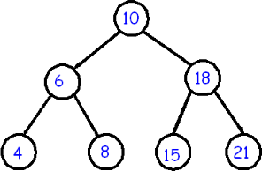
In the above tree all nodes in the left subtree of 10 have keys < 10 while all nodes in the
right subtree > 10. Because both the left and right subtrees of a BST are again search trees;

Slide 21
Binary Search Tree Operations:
Search Operation
Insertion Operation
Deletion Operation
Search Operation :Search Operation is performed to search a particular element in the
Binary Search Tree.
Rules
For searching a given key in the BST,
Compare the key with the value of root node.
If the key is present at the root node, then return the root node.
If the key is greater than the root node value, then recur for the root node’s right subtree.
If the key is smaller than the root node value, then recur for the root node’s left subtree.

Slide 22
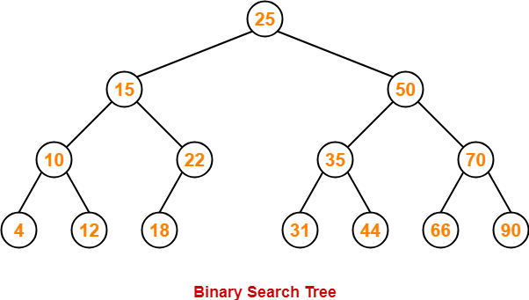
Example
Consider key = 45 has to be searched in the given BST-
We start our search from the root node 25.
As 45 > 25, so we search in 25’s right subtree.
As 45 < 50, so we search in 50’s left subtree.
As 45 > 35, so we search in 35’s right subtree.
As 45 > 44, so we search in 44’s right subtree but 44 has no subtrees.
So, we conclude that 45 is not present in the above BST.

Slide 23
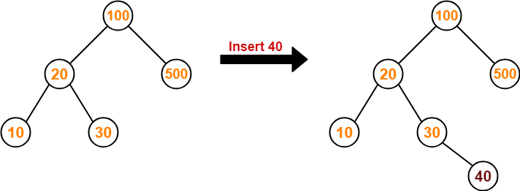
Insertion Operation-Insertion Operation is performed to insert an element in the Binary Search
Tree.
Rules
The insertion of a new key always takes place as the child of some leaf node.
For finding out the suitable leaf node,
Search the key to be inserted from the root node till some leaf node is reached.
Once a leaf node is reached, insert the key as child of that leaf node.
Example
Consider the following example where key = 40 is inserted in the given BST-

Slide 24
We start searching for value 40 from the root node 100.
As 40 < 100, so we search in 100’s left subtree.
As 40 > 20, so we search in 20’s right subtree.
As 40 > 30, so we add 40 to 30’s right subtree.
Deletion Operation-Deletion Operation is performed to delete a particular element from the Binary Search Tree.
Case-01: Deletion of A Node Having No Child (Leaf Node)
Just remove / disconnect the leaf node that is to deleted from the tree.
Example
Consider the following example where node with value = 20 is deleted from the BST-

Slide 25
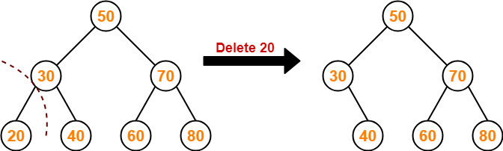
Case-02: Deletion of A Node Having Only One Child
Just make the child of the deleting node, the child of its grandparent.
Example
Consider the following example where node with value = 30 is deleted from the BST-

Slide 26
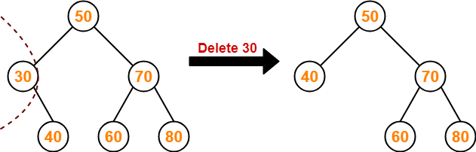
Case-02: Deletion of A Node Having Two Children-
A node with two children may be deleted from the BST in the following two ways-
Method-01:
Visit to the right subtree of the deleting node.
Pluck the least value element called as inorder successor.
Replace the deleting element with its inorder successor.
Example
Consider the following example where node with value = 15 is deleted from the BST-

Slide 27
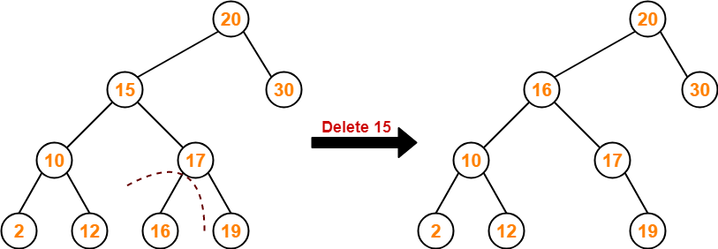
Method-02:
Visit to the left subtree of the deleting node.
Pluck the greatest value element called as inorder predecessor.
Replace the deleting element with its inorder predecessor.
Example
Consider the following example where node with value = 15 is deleted from the BST-

Slide 28
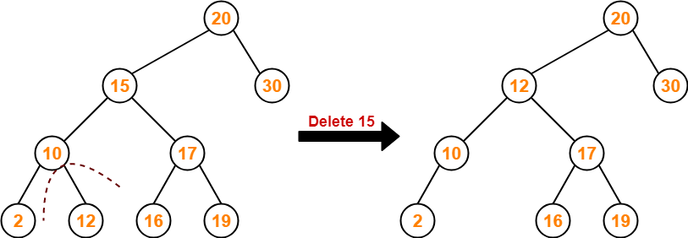
The time complexity of all these operations is O(h), where h is the height of the tree. Represents
the longest path we can take.
In the best case, h = O(log n) and all operations take time O(log n).
In the worst case, h = Θ(n) and some operations will take time Θ(n).

Slide 29
Traversals of Binary Trees:
A traversal is a process that visits all the nodes in the tree. Since a tree is a nonlinear data structure, there is no unique traversal. We will consider several traversal algorithms with we
group in the following two kinds.
Depth-First Traversal
Breadth-First Traversal
There are three different types of Depth-First Traversals,
PreOrder traversal - visit the parent first and then left and right children;
InOrder traversal - visit the left child, then the parent and the right child;
PostOrder traversal - visit the left child, then the right child, and then the parent;

Slide 30
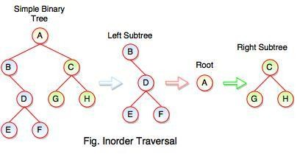
Inorder Traversal
Inorder Traversal: B E D F A G C H
Following steps can be defined the flow of inorder traversal:
Step 1 : B + (Inorder on E) + D + (Inorder on F) + (Root A ) + (Inorder on G) + C (Inorder on H) Step 2 : B + (E) + D + (F) + A + G + C + H
Step 3: B + E + D + F + A + G + C + H
Inorder Traversal: B E D F A G C H
Algorithm
Step 1: Start from the Left Subtree.
Step 2: Then, visit the Root.
Step 3: Then, go to the Right Subtree.

Slide 31
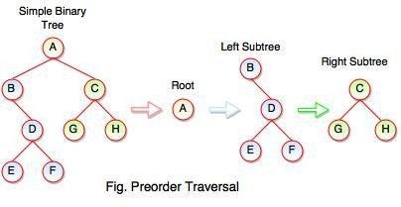
Preorder Traversal
Preorder Traversal: A B C D E F G H
Following steps can be defined the flow of preorder traversal:
Step 1: A + B (B + Preorder on D (D + Preorder on E and F)) + C (C + Preorder on G and H)
Step 2: A + B + D (E + F) + C (G + H)
Step 3: A + B + D + E + F + C + G + H
Preorder Traversal: A B C D E F G H
Algorithm
Step 1: Start from the Root.
Step 2: Then, go to the Left Subtree.
Step 3: Then, go to the Right Subtree.

Slide 32
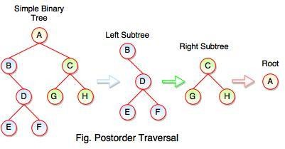
Postorder Traversal : E F D B G H C A
Postorder Traversal
Algorithm
Step 1: Start from the Left Subtree (Last Leaf).
Step 2: Then, go to the Right Subtree.
Step 3: Then, go to the Root.
Following steps can be defined the flow of postorder traversal:
Step 1: As we know, preorder traversal starts from left subtree (last leaf) ((Postorder on E + Postorder on F) + D + B )) + ((Postorder on G + Postorder on H) +
C) + (Root A)
Step 2: (E + F) + D + B + (G + H) + C + A
Step 3: E + F + D + B + G + H + C + A
Postorder Traversal : E F D B G H C A

Slide 33
Inorder: visit left subtree, visit root, visit right subtree | Preorder: visit root, visit left, visit right | Postorder: visit left, visit right, visit root
private void Inorder (BSTNode root) { if(root != null) { Inorder(root.left); Process(root.value); Inorder(root.right); } } public void Inorder() { Inorder(root); } | Private void Preorder (BSTNode root) { if(root != null) { Process(root.value); Preorder(root.left); Preorder(root.right); } } public void Preorder(){ Preorder(root); } | private void Postorder (BTSNode root){ if(root != null) { Postorder(root.left); Postorder(root.right); Process(root.value); }} public void Postorder(){ Postorder(root); }

Slide 34
Breadth-First Traversal:
Depth-first is not the only way to go through the elements of a tree. Another way is to go through
them level-by-level.For example, each element exists at a certain level (or depth) in the tree:
j
/ \
f k <-- level 1
/ \ \
a h z <-- level 2
\
d
<-- level 0
<-- level 3
This level-by-level traversal is called a breadth-first traversal because we explore the breadth, i.e., full
width of the tree at a given level, before going deeper.

Slide 35
Balanced binary trees
A balanced binary tree is one in which the largest path through the left sub tree is the same length as the largest path of the right sub tree, i.e., from root to leaf.
Searching time is very less in balanced binary trees compared to unbalanced binary tree. i.e.,
balanced trees are used to maximize the efficiency of the operations on the tree.
There are two types of balanced trees :
Height Balanced Trees
Weight Balanced Trees

Slide 36
Height balanced trees
There are two main approaches, which may be used to balance (or decrease) the depth of a binary
tree :
Insert a number of elements into a binary tree in the usual way, using the algorithm given in the
previous section (i.e., Binary search Tree insertion). After inserting the elements, copy the tree
into another binary tree in such a way that the tree is balanced. This method is efficient if the data(s) are continually added to the tree.
Another popular algorithm for constructing a height balanced binary tree is the AVL tree.
AVL tree
This algorithm was developed in 1962 by two Russian Mathematicians, G.M. Adel’son Vel’sky and
E.M. Landis; here the tree is called AVL Tree.
A binary tree is said to be balanced if the height of left and right children of every node differ by either
- 1, 0 or +1. In an AVL tree, every node maintains an extra information known as balance factor.

Slide 37
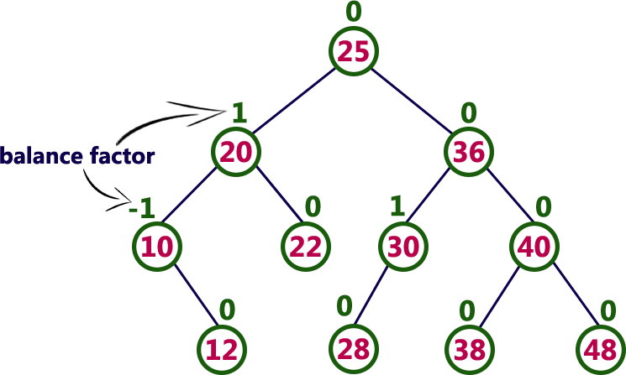
In an AVL tree, balance factor of every node is either -1, 0 or +1.
Balance factor = heightOfLeftSubtree – heightOfRightSubtree

Slide 38
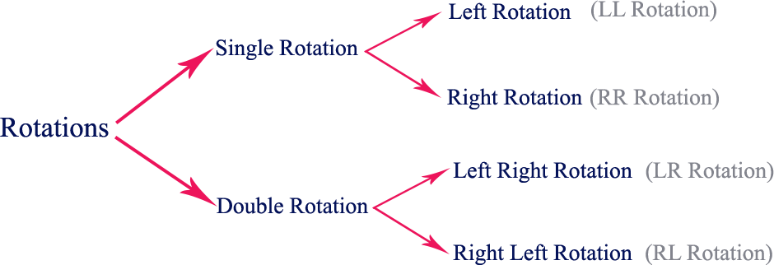
AVL Tree Rotations:
In AVL tree, after performing operations like insertion and deletion we need to check the balance
factor of every node in the tree.
If the tree becomes imbalanced due to any operation, we use rotation operations to make the tree balanced.
Rotation is the process of moving nodes either to left or to right to make the tree balanced.
Four types of rotations and they are classified into two types.

Slide 39
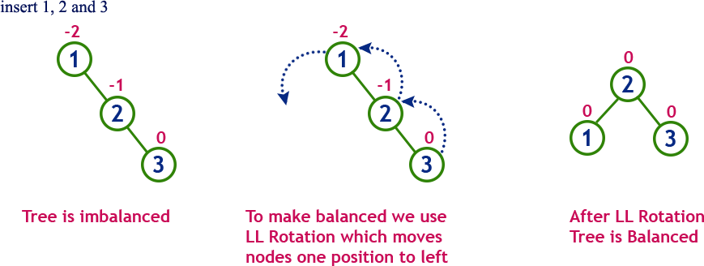
Left Rotation:
If a tree becomes unbalanced, when a node is inserted into the right subtree of the right subtree, then we perform a single left rotation.

Slide 40
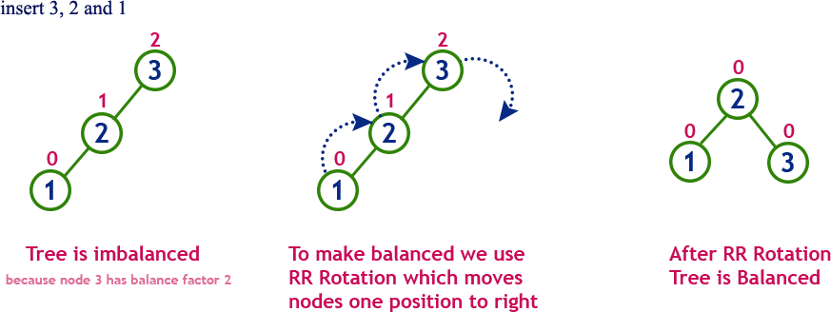
Right Rotation
AVL tree may become unbalanced, if a node is inserted in the left subtree of the left subtree. The
tree then needs a right rotation.

Slide 41
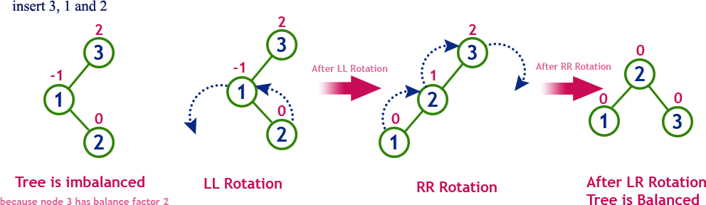
Left-Right Rotation
In LR Rotation, at first, every node moves one position to the left and one position to right from the current position.

Slide 42
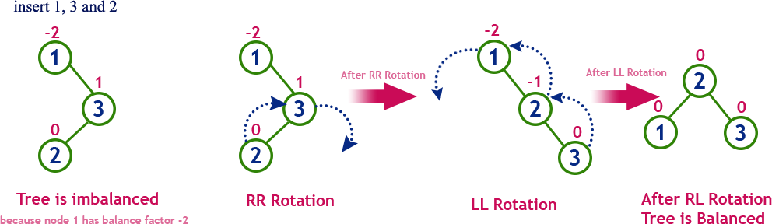
Right Left Rotation:
In RL Rotation, at first every node moves one position to right and one position to left from the
current position.

Slide 43
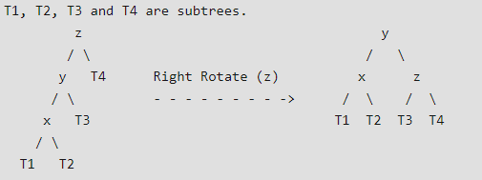
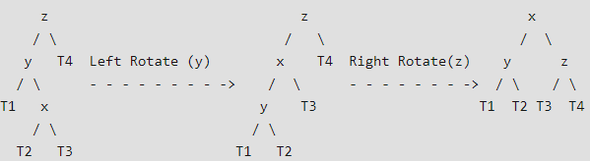
Some Special cases:
Left Left Case
Left Right Case

Slide 44
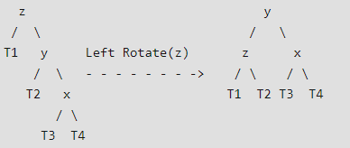
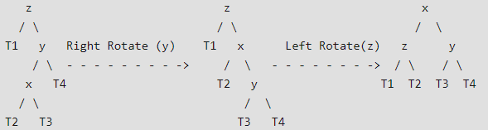
Right Right Case
Right Left Case

Slide 45
The following operations are performed on AVL tree...
Search
Insertion
Deletion
Example
Build an AVL tree with the following values: 15, 20, 24, 10, 13, 7, 30, 36, 25

Slide 46
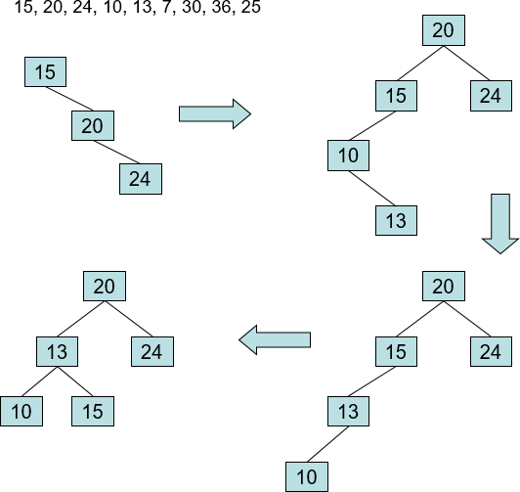

Slide 47
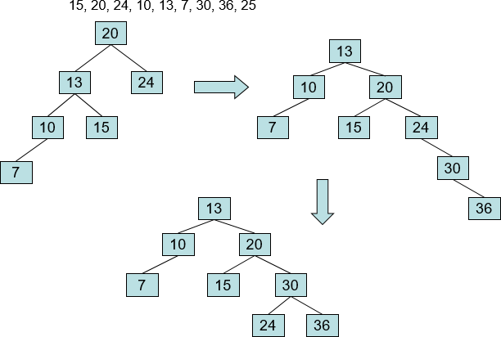

Slide 48
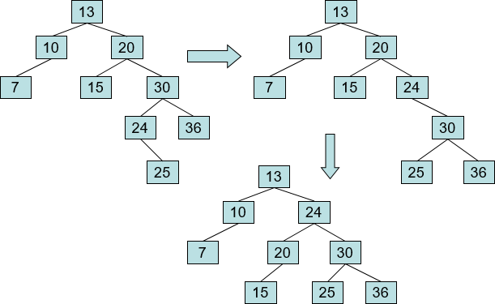

Slide 49
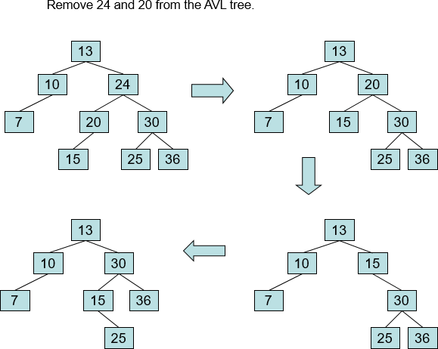
The deletion operation in AVL Tree is similar to deletion operation in BST.
But after every deletion operation, we need to check with the Balance Factor condition. If the tree is balanced after deletion go for next operation otherwise perform suitable rotation to make the tree Balanced.

Slide 50
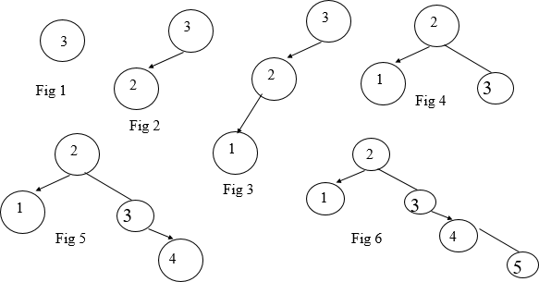
Example
Insert 3,2,1,4,5,6,7, 16,15,14

Slide 51
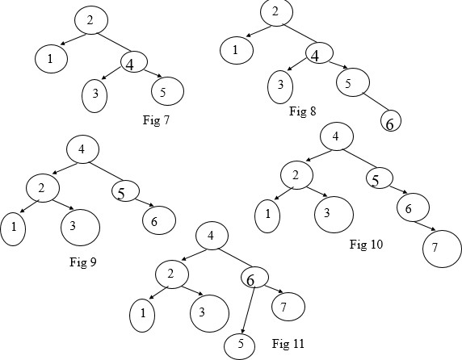

Slide 52
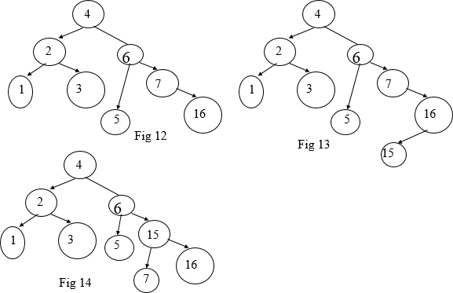

Slide 53
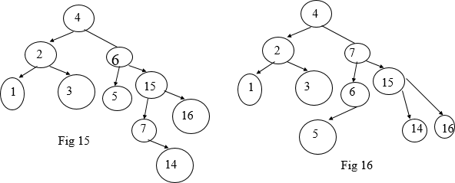

Slide 54
Applications:
Memory management subsystem of Linux kernel to search memory regions of processes during preemption.
Data analysis, data mining
Time complexity: O(log n)

Slide 55
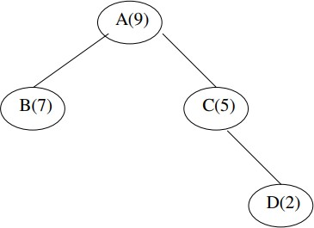
Weight balanced tree
A weight-balanced tree is a balanced binary tree in which additional weight field is also there. The
nodes of a weight-balanced tree contain four fields :
Data Element
Left Pointer
Right Pointer
A probability or weight field
The data element, left and right pointer fields are save as that in any other tree node. The probability field is a specially added field for a weight-balanced tree.

Slide 56
B-Tree
B-Tree was developed in the year 1972 by Bayer and McCreight with the name Height Balanced m-way Search Tree. Later it was named as B-Tree.
B-Tree is a self-balanced search tree in which every node contains multiple keys and has more than two children.
B-Tree of Order m has the following properties
Property 1 - All leaf nodes must be at same level.
Property 2 - All nodes except root must have at least [m/2]-1 keys and a maximum of m-1 keys.
Property 3 - All non-leaf nodes except root (i.e. all internal nodes) must have at least m/2 children.
Property 4 - If the root node is a non-leaf node, then it must have at least 2 children.
Property 5 - A non-leaf node with n-1 keys must have n number of children.
Property 6 - All the key values in a node must be in Ascending Order.

Slide 57
For example, B-Tree of Order 4 contains a maximum of 3 key values in a node and maximum of 4 children
for a node
Insertion Operation in B-Tree
Step 1 - Check whether tree is Empty.
Step 2 - If tree is Empty, then create a new node with new key value and insert it into the tree as a root node. Step 3 - If tree is Not Empty, then find the suitable leaf node to which the new key value is added using Binary
Search Tree logic.
Step 4 - If that leaf node has empty position, add the new key value to that leaf node in ascending order of key value within the node.
Step 5 - If that leaf node is already full, split that leaf node by sending middle value to its parent node. Repeat
the same until the sending value is fixed into a node.
Step 6 - If the spilting is performed at root node then the middle value becomes new root node for the tree and
the height of the tree is increased by one.

Slide 58
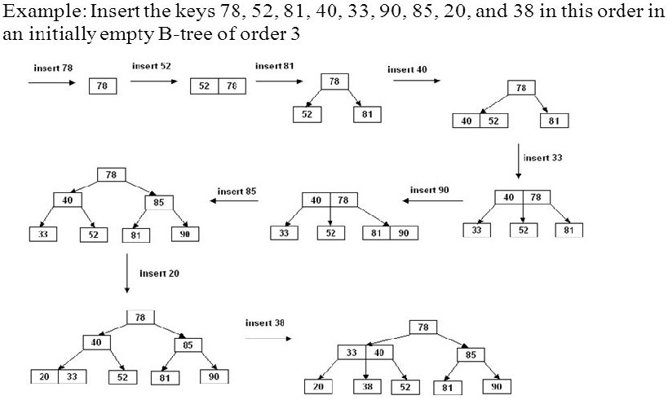
Construct a B-Tree of Order 3
Key=m-1 i,e. non-leaf node with M children contains M − 1 keys. and non-leaf node (except root) has at least M

Slide 59
Complexity of B Tree operations
max depth of an order m BTree is h=⌈log⌈m/2⌉​(n)⌉
At each node, we do O(log m) work to choose branch
An insert or delete may need O(m) work to fix up info in a node
Worst cases are:
find: O(log(m)⋅logm(n))
But, since logm(n)=log(n)log(m), this simplifies to O(log(n)).
insert/delete: O(mlogm(n))=O(mlog(m)log(n))
Applications
B-trees are preferred when decision points, called nodes, are on hard disk rather than in random-
access memory (RAM)
B-trees save time by using nodes with many branches (called children), compared with binary trees, in which each node has only two children, thereby speeding up the process.

Slide 60
Huffman tree
Huffman algorithm or Huffman coding is an entropy encoding algorithm.
It is used widely for data compression (like Winzip Compression-Winzip doesn’t use it but!)
Huffman coding tree or Huffman tree is a full binary tree in which each leaf of the tree corresponds to a letter in the given alphabet.
This is a technique which is used in a data compression or it can be said that it is a coding technique
which is used for encoding data.
Huffman coding is used in JPEG compression.
Greedy method
This technique is a mother of all data compression scheme.
This idea is basically dependent upon the frequency, i.e. the frequency of the corresponding character
which needs to be compressed, and by that frequency, only Huffman code will be generated.
In case of Huffman coding, the most generated character will get the small code and least generated character will get the large code.

Slide 61
Huffman tree is a specific method of representing each symbol.
This technique produces a code in such a manner that no codeword is a prefix of some other code word. These codes are called as prefix code.

Slide 62
Huffman Algorithm
Step 1: Create a leaf node for each character. Add the character and its weight or frequency of
occurrence to the priority queue.
Step 2: Repeat Steps 3 to 5 while the total number of nodes in the queue is greater than 1 Step 3: Remove two nodes that have the lowest weight (or highest priority)
Step 4: Create a new internal node by merging these two nodes as children and with weight equal to the sum of the two nodes' weights.
Step 5: Add the newly created node to the queue. Step 6: Add the newly created node to the queue.

Slide 63
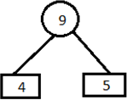
Example
Let obtain a set of Huffman code for the message (m1.....m7) with relative frequencies (q1.....q7) = (4,5,7,8,10,12,20). Let us draw the Huffman tree for the given set of codes.
Step 1: Arrange the data in ascending order in a table.
4,5,7,8,10,12,20
Step 2: Combine first two entries of a table and by this create a parent node.

Slide 64
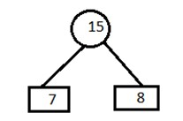
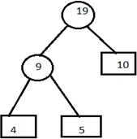
Step 3:
A) Remove the entries 4 and 5 from the table and inert 9 at its appropriate position. 7,8,9,10,12,20
Combine minimum value of table and create a parent node.
B) Now remove the entries 7 and 8 from the table
position. 9,10,12,15,20
Combine minimum value of two blocks and create a parent node.
and insert 15 at its appropriate

Slide 65
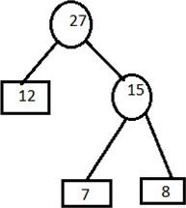
C) Remove the entries 9 and 10 from the table and insert 19 at its proper position. 12,15,19,20.
Combine minimum value of two blocks and create parent node.
D) Remove the entries 15 and 12 from the table and insert 27 at its appropriate position. 19,20,27 Combine minimum value of two blocks and create parent node.

Slide 66
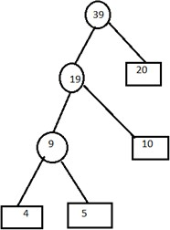
E) Remove the entries 19 and 20 from the table and insert 39 in the table. 27,39
Combine minimum value of two blocks and create parent node.

Slide 67
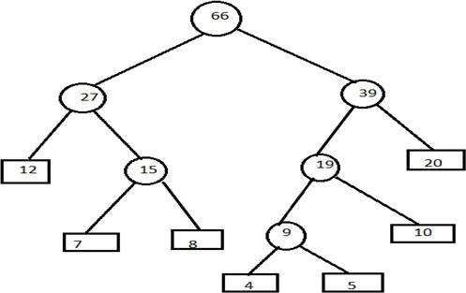

Slide 68
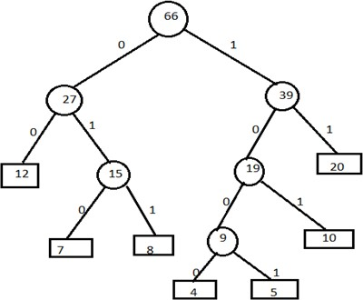
Step 4: Now assign left child as 0 and right child as 1 to encode the frequencies.
Now, codes for the given frequencies are given below:
Characters | Codes | counts
4 | 1000 | 4
5 | 1001 | 4
7 | 010 | 3
8 | 011 | 3
10 | 101 | 3
12 | 00 | 2
20 | 11 | 2

Slide 69
Important Formulas:
Formula 1: Average code length per character=∑ (probability i* code length i)
Formula 2: Total number of bits in Huffman encoded message= Total number of characters in the
message x Average code length per character
= ∑ ( frequency i * Code length i)
Time complexity: O(n log n) is the overall time complexity. Where n is the number of characters.

Slide 70

Example
Assume that relative frequencies are:
A: 40
B: 20
C: 10
D: 10
R: 20
Step 1: Smallest number are 10 and 10 (C and D), so connect those

Slide 71
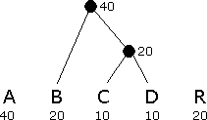
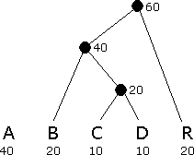
Step 2: C and D have already been used, and the new node above them (call it C+D) has value 20
The smallest values are B, C+D, and R, all of which have value 20. So, Connect any two of these
Step 3: The smallest values is R, while A and B+C+D all have value 40. So , Connect R to either of the others

Slide 72


Step 5: Assign 0 to left branches, 1 to right branches, Each encoding is a path from the root
Step 4: Connect the final two nodes

Slide 73
Game Tree
A knowledge representation structure shaped like a decision tree. Nodes of the tree represent game positions possible through legal moves (from the position in the parent connecting node). The layers of the game tree expand or contract based on the possible legal moves at that point in the game.
Let’s consider a game of two players, and call them MIN and MAX. These two players will compete where MAX will try to maximize the payoff. A search problem in the form of a game can be defined with the following 4 components:
Initial state: This state indicates the board position and whose move it is
Terminal test: This test indicates when the game is over
Set of operators: These define the possible moves that a player can make
Payoff function / Utility function: This gives a numeric value for the outcome

Slide 74
In a normal search problem, the objective of MAX would be to search for a payoff value that leads to a terminal state that is a winner, thereby making its first move. However, in the presence of adversary MIN, the strategy of MAX will be to find a winning terminal state regardless of what move MIN makes.
Minimax Algorithm:
It is a decision tree algorithm
It is used backtracking method
The best move strategy is used for game play to beat opponent
Player Max will try to maximize the utility (Best move)
Player Min will try to minimize the utility (Worst move for player Max)

Slide 75
To determine the optimal strategy for MAX, the minimax algorithm is used to determine the best first move. The 5 steps in this algorithm are:
Generate the entire game tree till the terminal nodes.
Apply the payoff function to each terminal state to get its value.
Use the payoff of the terminal states to determine the payoff of the nodes one level
above in the search tree.
If node is terminal state return payoff value
If the node is at player Max, return max value of result of minimax function
If the node is at player Min, return min value of result of minimax function
Continue step 3 one layer at a time till you reach the root node.
Choose the move that leads to the highest payoff value.

Slide 76

Time complexity of minimax algorithm is O(b^{m})
Where, b is number of legal moves and m is maximum depth of tree Let’s take an example of game tree using minimax algorithm
Player Max try to get maximum value to win with maximum benefit
Player Min try to get minimum value to minimize player max benefit

Slide 77

Here, at the terminal node player Max is attached so first, Max player take the value which is maximum of two child i.e. 8 at node D. similarly -1 at node E, 2 at node F, and 4 at node G

Slide 78

Now the turn is goes to player Min who is try to minimize the benefit by taking minimum value. Player Min takes minimum value from node D and E to node B
i.e. -1 and 2 from node F and G to node C.

Slide 79

Now the turn goes to player Max, which take maximum value from node B and C to node A i.e. 2.
Here we reach to root node so game is over.
Hence, if player Max chooses the route A, C, F and terminal with max value, then player Max will win with payoff value 2.

Slide 80

Example: Tic tac toe game using minimax algorithm Suppose, Max move = X and Min move = O
Win = w and Draw = d

Slide 81
Hence, if player max chooses right most child then player max will definitely win. If player max chooses left most or middle child then chances of win is half.
Alpha Beta pruning algorithm:
This algorithm is advance version of minimax algorithm. It is used to cutoff the number of
search by exploring less number of nodes.
Let’s explain by the help of following game tree.

Slide 82

Here, the Alpha is the player max and Beta is the player min. Terminal is the leaf node which contains the payoff value.
Player max try to get maximum value from terminal and player min try to get minimum value
from terminal.
Here the player min is connected to terminal so it chooses the min value from the terminal.

Slide 83


Slide 84

Here, min player which is beta, chooses the minimum value from the terminal and pass to the player max which is alpha. The max player searches the value greater than 3 from the child. If found replace the value 3 by maximum value otherwise prune the node. This process goes on to root node.
Here in the above figure, if max player choose the left child first it will win with payoff value 3.

Slide 85

Comparison of Search Trees

Slide 86
Graph

Slide 87
Contents
Introduction and Representation of Graph
Transitive Closure, Floyd-Warshall algorithm
Graph traversal
Minimum spanning tree: Kruskal and Prims Algorithm
Shortest path Algorithms: Dijkstra Algorithm and Bellman Ford

Slide 88
Introduction of Graph
Graph is a non-linear data structure; A map is a well-known example of a graph. In a map
various connections are made between the cities. The cities are connected via roads, railway lines and aerial network. We can assume that the graph is the interconnection of cities by roads. Euler used graph theory to solve Seven Bridges of Königsberg problem. Is there a possible way to traverse every bridge exactly once – Euler Tour
A graph contains a set of points known as nodes (or vertices) and set of links known as edges
(or Arcs) which connects the vertices.
A graph G is represented as G = ( V , E ), where V is set of vertices and E is set of edges.
Example: graph G can be defined as G = ( V , E ) Where V = {A,B,C,D,E} and E =
{(A,B),(A,C)(A,D),(B,D),(C,D),(B,E),(E,D)}. This is a graph with 5 vertices and 6 edges

Slide 89

Graph Terminology
Vertex : An individual data element of a graph is called as Vertex. Vertex is also known as node. In above example graph, A, B, C, D & E are known as vertices.
Edge : An edge is a connecting link between two vertices. Edge is also known as Arc. An edge
is represented as (starting Vertex, ending Vertex).
In above graph, the link between vertices A and B is represented as (A,B).

Slide 90
Edges are three types:
Undirected Edge - An undirected edge is a bidirectional edge. If there is an undirected edge between vertices A and B then edge (A , B) is equal to edge (B , A).
Directed Edge - A directed edge is a unidirectional edge. If there is a directed edge between vertices A and B then edge (A , B) is not equal to edge (B , A).
Weighted Edge - A weighted edge is an edge with cost on it.
Degree: Total number of edges connected to a vertex is said to be degree of that vertex.
Indegree: Total number of incoming edges connected to a vertex is said to be indegree of that vertex.
Outdegree: Total number of outgoing edges connected to a vertex is said to be outdegree of that vertex.
Parallel edges or Multiple edges: If there are two undirected edges to have the same end vertices, and for two directed edges to have the same origin and the same destination. Such edges are called
parallel edges or multiple edges.

Slide 91

Here, in degree of nodes:- A = 0
B = 2
C = 2
D = 6
E = 1
F = 0
G = 1
Out degree of A = 3 B = 1
C = 1
D = 0
E = 2
F = 3
G = 2

Slide 92

Sub Graph: A graph S is said to be a sub graph of a graph G if all the vertices and all the edges of S are in G, and each edge of S has the same end vertices in S as in G. A subgraph of G is a graph G’ such that V(G’) ⊆ V(G) and E(G’) ⊆ E(G)

Slide 93


Types of Graphs
1.Undirected Graph: A graph with only undirected edges is said to be undirected graph.
2. Directed Graph: A graph with only directed edges is said to be directed graph.

Slide 94


3. Complete Graph: A graph in which any V node is adjacent to all other nodes present in the graph is known as a complete graph. An undirected graph contains the edges that are equal to edges = n(n-1)/2 where n is the number of vertices present in the graph. The following figure shows a complete graph.
4. Regular Graph: Regular graph is the graph in which nodes are adjacent to each other, i.e., each node is accessible from any other node. Regular graph has all vertices with the same degree (number of connections). A complete graph is always regular, but a regular graph isn't always complete.

Slide 95


5. Cycle Graph: A graph having cycle is called cycle graph. In this case the first and last nodes are the same. A closed simple path is a cycle.
6. Acyclic Graph: A graph without cycle is called acyclic graphs.

Slide 96

7. Weighted Graph: A graph is said to be weighted if there are some non negative value assigned to each edges of the graph. The value is equal to the length between two vertices. Weighted graph is also called a network.

Slide 97
ADT of Graph:
Graph Create() : return an empty graph
Graph InsertVertex(graph, v): return a graph with v inserted. v has no edge.
Graph InsertEdge(graph, v1,v2): return a graph with new edge between v1 and v2
Graph DeleteVertex(graph, v) :return a graph in which v and all edges incident to it are
removed
Graph DeleteEdge(graph, v1, v2): return a graph in which the edge (v1, v2) is removed Boolean IsEmpty(graph): if (graph==empty graph) return TRUE else return FALSE List Adjacent(graph,v): return a list of all vertices that are adjacent to v

Slide 98
Representation of Graph
following ways:-
Sequential representation (adjacency matrix)
linked list representation (adjacency list)
Incidence Matrix
Adjancy matrix:
Adjancy matrix is the matrix which keeps information of adjacent nodes i.e. keeps the information weather node is adjacent to any other node or not. Suppose there are four nodes in a graph then row one represents the node 1, row 2 represents the node 2 & so on .
Similarly, column 1 represents node 1 & column 2 represents node 2 & so on. The entry of the matrix will be.
= 1 if there is an edge from node I to node j
= 0 if there is no edge from node I to node j.
Arr[i][j]

Slide 99


Example : for undirected graph
For a Directed graph

Slide 100


Adjacency List:
In this representation, every vertex of graph contains list of its adjacent vertices. The n rows of the adjacency matrix are represented as n chains. The nodes in chain I represent the vertices that are adjacent to vertex i.
It can be represented in two forms. In one form, array is used to store n vertices and chain is used to store its adjacencies.

Slide 101


So that we can access the adjacency list for any vertex in O(1) time. Adjlist[i] is a pointer to to first node in the adjacency list for vertex i.
Another type of representation is given below.
Consider the following directed graph representation implemented using linked list.
This representation can also be implemented using array

Slide 102
Incidence Matrix:
In this representation, the graph is represented using a matrix of size total number of vertices by a total number of edges. That means graph with 4 vertices and 6 edges is represented using a matrix of size 4X6. In this matrix, rows represent vertices and columns represents edges.
This matrix is filled with 0 or 1 or -1. Here, 0 represents that the row edge is not connected to column vertex, 1 represents that the row edge is connected as the outgoing edge to column vertex and -1 represents that the row edge is connected as the incoming edge to column vertex.
For example, consider the following directed graph representation.

Slide 103


Slide 104

Transitive Closure of Graph
Transitive Closure is the reachability matrix to reach from vertex u to vertex v of a graph. In the graph we have to find a vertex v which is reachable from another vertex u, for all vertex pairs (u, v).
The final matrix is the Boolean type. When there is a value 1 for vertex u to vertex v, it means that there is at least one path from u to v. When there is a value 0 for vertex u to vertex v, it means that there is no path from u to v.
Example: Find the transitive closure of the given graph.

Slide 105
Floyd-Warshall algorithm
Used to find all pair shortest path problems from a given weighted graph.
As a result of this algorithm, it will generate a matrix, which will represent the minimum distance from any node to all other nodes in the graph. Time complexity: O(n³)
Algorithm:
Step 1: Start
Step 2: Create a [n x n] matrix say M
Step 3: For each cell (i,j) in M do if i = = j
Set all diagonal element value as 0 M[ i ][ j ] = 0 if (i , j) is an direct edge
M[ i ][ j ] = weight(i,j)

Slide 106
Else
Set value as infinite, there is no direct edge between the vertices,M[ i ][ j ] = ∞
Step 4:
for k from 1 to n for i from 1 to n for j from 1 to n
if M[ i ][ j ] > M[ i ][ k ] + M[ k ][ j ]
M[ i ][ j ] = M[ i ][ k ] + M[ k ][ j ]
Step 5: Stop

Slide 107

Example: Find the Warshall’s algorithm.
shortest path between all the vertex in the following graph using
Solution:
Formula to calculate the distance between vertices is D^{k} [i,j]= min {D^{k-1} [i,j], D^{k-1} [i,k]+D^{k-1} [k,j]}
Create a distance matrix (D⁰) for all the vertex of the graph which are directly connected.

Slide 108

Create a distance matrix (D¹) for all the vertex of the graph which are connectedvia vertex 1.
D¹ [i,j]= min {D⁰ [i,j], D⁰ [i,k]+D⁰ [k,j]}
D¹ [2,3]= min {D⁰ [2,3], D⁰ [2,1]+D⁰ [1,2]}
D¹ [2,3]= min (1, infinite)
D¹ [2,3]=1

Slide 109


Likewise find all the distance between vertices
Create a distance matrix (D²) for all the vertex of the graph which are connected via vertex 2.

Slide 110


Create a distance matrix (D³) for all the vertex of the graph which are connectedvia vertex 3.
Create a distance matrix (D⁴) for all the vertex of the graph which are connected via vertex 4.
This is the final distance matrix for all the vertices.

Slide 111
Graph Traversal
Graph traversal is a technique used for searching a vertex in a graph.
The graph traversal is also used to decide the order of vertices is visited in the search
process.
A graph traversal finds the edges to be used in the search process without creating loops. That means using graph traversal we visit all the vertices of the graph without getting into looping path.
There are two types of graph traversal techniques and they are as follows
BFS (Breadth First Search/ Level Order Search)
DFS (Depth First Search)

Slide 112
BFS (Breadth First Search)
BFS traversal of a graph produces a spanning tree as final result. Spanning Tree is a graph without loops.
We use Queue data structure with maximum size of total number of vertices in the graph to implement BFS traversal.

Slide 113
Algorithm for BFS Step 1: Start
Step 2: Define a Queue of size total number of vertices in the graph.
Step 3: Select any vertex as starting point for traversal. Visit that vertex and insert it into the Queue.
Step 4: Visit all the non-visited adjacent vertices of the vertex which is at front of the Queue and insert them into the Queue.
Step 5: When there is no new vertex to be visited from the vertex which is at front of the Queue then delete that vertex.
Step 6: Repeat steps 4 and 5 until queue becomes empty.
Step 6: When queue becomes empty, then produce final spanning tree by removing unused edges from the graph
Step 7: Stop

Slide 114


Example: Display all the value from the following graph using BFS Traversal
Solution:
Step 1: Select the vertex A as starting vertex, visit A and insert into the queue

Slide 115


Step 2: Visit all the adjacent vertices of A which are not visited (B,D,E) and insert newly visited vertices into the queue and delete A from queue.
Step 3: Visit all the adjacent vertices of D which are not visited (no vertices) and delete D from
queue.

Slide 116


Step 4: Visit all the adjacent vertices of E which are not visited (C,F) and insert newly
visited vertices into the queue and delete E from queue.
Step 5: Visit all the adjacent vertices of B which are not visited (no vertices) and delete B
from queue.

Slide 117


Step 6: Visit all the adjacent vertices of C which are not visited (G) and insert newly visited vertices into the queue and delete C from queue.
Step 7: Visit all the adjacent vertices of F which are not visited (no vertices) and delete F from queue.

Slide 118


Step 8: Visit all the adjacent vertices of G which are not visited (no vertices) and delete G
from queue.
Now the queue is empty. So, we stop the traversal here. Remove the unnecessary edges from the resulted graph and we can get a final spanning tree.
The resulted visited vertices are: A,D,E,B,C,F,G

Slide 119
DFS (Depth First Search)
DFS traversal of a graph produces a spanning tree as final result. Spanning Tree is a graph
without loops.
We use Stack data structure with maximum size of total number of vertices in the graph to implement DFS traversal.
Algorithm for DFS Step 1: Start
Step 2: Define a Stack of size total number of vertices in the graph.
Step 3: Select any vertex as starting point for traversal. Visit that vertex and push it on to the Stack.
Step 4: Visit any one of the non-visited adjacent vertices of a vertex which is at the top of stack and push it on to the stack.

Slide 120
Step 5: Repeat step 4 until there is no new vertex to be visited from the vertex which is at the top of the stack.
Step 6: When there is no new vertex to visit then use back tracking and pop one vertex from the stack.
Step 7: Repeat steps 4,5 and 6 until stack becomes Empty.
Step 8: When stack becomes Empty, then produce final spanning tree by removing unused edges from the graph
Step 9: Stop

Slide 121



Example: Visit and display all the value of following graph using DFS traversal.
Solution:
Step 1: Select vertex A as starting vertex, visit A and insert into the stack.

Slide 122




Step 2: Visit any one adjacent vertex of A which is not visited (B), push newly visited
vertex B into the stack.
Step 3: Visit any one adjacent vertex of B which is not visited (C), push newly visited vertex C
into the stack.

Slide 123




Step 4: Visit any one adjacent vertex of C which is not visited (E), push newly visited vertex E into the stack.
Step 5: Visit any one adjacent vertex of E which is not visited (D), push newly visited vertex
D into the stack.

Slide 124




Step 6: Visit any one adjacent vertex of D which is not visited (no vertex). So, use back tracking and pop D from the stack.
Step 7: Visit any one adjacent vertex of E which is not visited (F), push newly visited vertex F
into the stack.

Slide 125




Step 8: Visit any one adjacent vertex of F which is not visited (G), push newly visited vertex G into the stack.
Step 9: Visit any one adjacent vertex of G which is not visited (no vertex). So, use back
tracking and pop G from the stack.

Slide 126




Step 10: Visit any one adjacent vertex of F which is not visited (no vertex). So, use back tracking and pop F from the stack.
Step 11: Visit any one adjacent vertex of E which is not visited (no vertex). So, use back tracking and pop E from the stack.

Slide 127




Step 12: Visit any one adjacent vertex of C which is not visited (no vertex). So, use back tracking and pop C from the stack.
Step 13: Visit any one adjacent vertex of B which is not visited (no vertex). So, use back tracking and pop B from the stack.

Slide 128



Step 14: Visit any one adjacent vertex of A which is not visited (no vertex). So, use back tracking and pop A from the stack.
Here the stack is empty. So, we stop traversal here. Remove all the unnecessary edges from the final graph and get final spanning tree.
The final visited vertices are: A,B,C,E,D,F,G

Slide 129
Minimum Spanning Trees(MST)
Spanning forest is a forest that spans all of the vertices, meaning only that each vertex of the
graph is a vertex in the forest. For this definition, even a connected graph may have a
disconnected spanning forest, such as the forest in which each vertex forms a single- vertex tree.
A subgraph that spans (reaches out to) all vertices of a graph is called a spanning subgraph.
A subgraph that is a tree and that spans (reaches out to) all vertices of the original graph is called a spanning tree.
Among all the spanning trees of a weighted and connected graph, the one (possibly more)
with the least total weight is called a minimum spanning tree (MST).
Minimum Spanning Tree is a Spanning Tree which has minimum total cost. If we have a
linked undirected graph with a weight (or cost) combine with each edge. Then the cost of
spanning tree would be the sum of the cost of its edges.

Slide 130

Minimum Spanning Trees(MST)
A Minimum Spanning Tree (MST) is a subset of edges in a connected, weighted graph that:
Spans all vertices (i.e., connects all nodes).
Has no cycles (forms a tree).
Has the minimum possible total edge weight among all spanning trees.

Slide 131

Spanning tree
A spanning tree is a subset of Graph G, which has all the vertices covered with minimum possible number of edges. Hence, a spanning tree does not have cycles and it cannot be disconnected.
By this definition, we can draw a conclusion that every connected and undirected Graph G has at least one spanning tree. A disconnected graph does not have any spanning tree, as it cannot be spanned to all its vertices.

Slide 132
We found three spanning trees off one complete graph. A complete undirected graph can have maximum n^{n-2} number of spanning trees, where n is the number of nodes. In the above example, n is 3, hence 3³⁻² = 3 spanning trees are possible.
General Properties of Spanning Tree: We now understand that one graph can have more than one
spanning tree. Following are a few properties of the spanning tree connected to graph G
A connected graph G can have more than one spanning tree.
All possible spanning trees of graph G, have the same number of edges and vertices.
The spanning tree does not have any cycle (loops).
Removing one edge from the spanning tree will make the graph disconnected, i.e. the spanning tree is
minimally connected.
Adding one edge to the spanning tree will create a circuit or loop, i.e. the spanning tree is maximally
acyclic.

Slide 133



Slide 134

Generic MST Algorithm
A greedy algorithm is an approach where we make the best possible choice at each step, hoping to find the global optimum. It does not always guarantee the optimal solution for every problem, but it works well for problems like Minimum Spanning Tree (MST).
The greedy algorithm has only one chance to compute the optimal solution and thus, cannot
go back and look at other alternate solutions.
Example

Slide 135
To find the path with largest sum.
Following steps are followed to find the solution:
Step 1: Initialize sum = 0
Step 2: Select the root node, so sum = 0+8 = 8
Step 3: The algorithm compares nodes at next level, selects the largest node which is 12, so, sum 8+12=
20.
Step 4: The algorithm compares nodes at the next level, selects the largest node which is 10, making
the sum = 30.
Thus, using the greedy algorithm, we get 8-12-10 as the path. But this is not the optimal solution, since the path 8-2-89 has the largest sum i,e. 99.
This happens because the algorithm makes decision based on the information available at each step without considering the overall problem.

Slide 136
Most networking algorithms use the greedy approach. Here is a list of few of them −
Travelling Salesman Problem
Prim's Minimal Spanning Tree Algorithm
Kruskal's Minimal Spanning Tree Algorithm
Dijkstra's Minimal Spanning Tree Algorithm
Graph - Map Coloring
Graph - Vertex Cover
Knapsack Problem
Job Scheduling Problem

Slide 137
Applications of MST:
Minimum spanning trees are used for network designs (i.e. telephone or cable
networks).
They are also used to find approximate solutions for complex mathematical problems like the Traveling Salesman Problem. Other, diverse applications include:
Cluster Analysis.
Real-time face tracking and verification (i.e. locating human faces in a video stream).
Protocols in computer science to avoid network cycles.
Entropy based image registration.
Max bottleneck paths.
Dithering (adding white noise to a digital recording in order to reduce distortion)

Slide 138
Spanning Tree Algorithms
Kruskal's algorithm
Prim's Algorithm
Round Robin Algorithm
Kruskal's algorithm :
Prim’s and Kruskal’s Algorithm are the famous greedy algorithms.
Kruskal's algorithm is a minimum-spanning-tree algorithm which finds an edge of the least possible weight that connects any two trees in the forest.
It is a greedy algorithm in graph theory as it finds a minimum spanning tree for a connected weighted graph adding increasing cost arcs at each step.
ordering the edges by cost and representing the blue trees so that we can test whether two vertices are in the same blue tree.

Slide 139
Step to Kruskal’s algorithm
Sort the graph edges with respect to their weights.
Start adding edges to the minimum spanning tree from the edge with the smallest weight
until the edge of the largest weight.
Only add edges which don’t form a cycle—edges which connect only disconnected components.
Or as a simpler explanation,
Remove all loops and parallel edges
Arrange all the edges in ascending order of cost
Add edges with least weight

Slide 140
Pseudocode
KRUSKAL(G):
A = ∅
For each vertex v ∈ G.V:
MAKE-SET(v)
For each edge (u, v) ∈ G.E ordered by
increasing order by weight(u, v):
if FIND-SET(u) ≠ FIND-SET(v):
A = A 𝖴 {(u, v)}
UNION (u, v)
return A
Kruskal’s Algorithm is preferred when-
The graph is sparse.
There are less number of edges in the graph like E = O(V)
The edges are already sorted or can be
sorted in linear time.

Slide 141


Slide 142
Prim’s Algorithm:
It is used for finding the Minimum Spanning Tree (MST) of a given graph.
To apply Prim’s algorithm, the given graph must be weighted, connected and undirected. The implementation of Prim’s Algorithm is explained in the following steps-
Step-1:
Randomly choose any vertex.
The vertex connecting to the edge having least weight is usually selected.
Step-2:
Find all the edges that connect the tree to new vertices.
Find the least weight edge among those edges and include it in the existing tree.
If including that edge creates a cycle, then reject that edge and look for the next least weight edge.

Slide 143
Step-3:
Keep repeating step-02 until all the vertices are included and Minimum Spanning Tree (MST) is obtained.
Prim’s Algorithm is preferred when-
The graph is dense.
There are large number of edges in the graph like E = O(V²).
Worst case time complexity of Prim’s Algorithm is-
O(ElogV) using binary heap
O(E + VlogV) using Fibonacci heap

Slide 144


Q. Construct the minimum spanning tree (MST) for the given graph using Prim’s Algorithm.
Solution-
Step-01:

Slide 145




Step-2:
Step-4:
Step-3:
Step-5:

Slide 146

Step-6:
Since all the vertices have been included in the
MST, so we stop.
Now, Cost of Minimum Spanning Tree
= Sum of all edge weights
= 10 + 25 + 22 + 12 + 16 + 14
= 99 units

Slide 147


Slide 148
Round Robin Algorithm
The round robin algorithm for the minimum spanning tree problem can be viewed as another special case of the general greedy method.
It builds a collection of blue trees, by repeatedly merging trees using the following rule, until there is just one tree left. Coloring Rule.
Select a blue tree and minimum cost edge incident to it. Color the edge blue
An edge is incident to a tree if one of its endpoints is in the tree and the other is not.
To carry out a coloring step, we remove the first tree, say T1, from the front of the queue and perform a findmin on its heap. We color blue the edge, say e, returned by the findmin. We remove from the queue the other tree, say T2, incident to e. We update the vertex sets and edge heaps to reflect the combining of T1 and T2 and add the new blue tree to the rear of the queue. O(n).

Slide 149

Fig: Execution of the round-robin algorithm, (a) Input graph. The queue contains the vertex sets of the blue trees,
(b) After the initial pass through the queue. Edges {a, c}, {b, d}, {e, g}, and {c, f} become blue, (c) After another
pass. Edges {c, d}and {d, e} become blue.

Slide 150
set function minspantree (set vertices),
set blue;
map h; list queue;
vertex v, w; blue={};
queue = [ ]
for v ⊂ vertices —> makeset (v); h[v) - makeheap (edges (v)); queue = queue & [v] rof;
do | queue | > 1 —>
{v, w)=findmin h(queue (1))); blue= blue 𝖴 (v, w ,};- Queue= queue – {find (v), find (w)};
h{link (find (v), find (w))) = meld (h(find (v)), h(find (w)));
queue= queue & [find (v)]
od;
return blue
end minspantree;
predicate deleted (edge {v, ›w}); return find (v) =find (w)
end deleted;
real function key (edge e); return cost (e)
end key;

Slide 151
Shortest Path Algorithms
The shortest path problem is about finding a path between vertices in a graph such that the
total sum of the edges weights is minimum.
The most important algorithms for solving this problem are: Dijkstra's algorithm solves the single-source shortest path problem with non-negative edge weight. Bellman– Ford algorithm solves the single-source problem if edge weights may be negative.
Dijkstra's Algorithm
Dijkstra's Algorithm finds the shortest path between a given node (which is called the "source node") and all other nodes in a graph.
This algorithm uses the weights of the edges to find the path that minimizes the total distance (weight) between the source node and all other nodes.

Slide 152
Algorithm
Step 1: Remove all the loops.
Step 2: Remove parallel edges between two vertices which have higherweight/cost.
Step 3: Create weight matrix table
Set 0 to the source vertex and infinite to the remaining vertex.
Mark the smallest unmarked value and write that vertex in marked column.
Find those vertices which are directly connected to marked vertex and update all. If d[u] + c[u,v] < d[v] Then, d[v] = d[u] + c[u,v] OR,
New destination = Min(Old dest, Marked Value + Edge Weight)
Repeat stem b and c until final destination vertex is marked.

Slide 153
Step 4: Now, find the shortest path graph using backward tracking method.
Point to the final destination vertex and take it as an initial path.
Move pointer to the position where vertex value is change in samevertex.
Update pointer to that row where the smallest marked value of that row (which is other
vertex value).
Repeat stem b and c until source vertex is reached.
Finally reverse the order of vertex.

Slide 154

Example: Using Dijkstra’s algorithm find the shortest path from A to F for the following
graph.
Solution:
Step 1: Remove all the loops. (Edges that start and end at the same vertex is called loop) In the above graph there are two loops. One is in the vertex C and another one is in the Vertex F (starting and ending vertex are same), thus we remove this two edge.

Slide 155

Step 2: Remove all parallel edges between two vertices except the one with leastweight.
In the above graph there are two edges from A vertex to B vertex, and there cost/weight are 4 and 2.This two edges are called parallel edges. We remove that edge which one has greater value (4>2) i.e. 4. So we remove that edge of cost 4.
Similarly, there is another parallel edge from E to F, and as per the rules we remove that edge which one has greater value (6>3) i.e. 6. So we remove that edge of cost 6.

Slide 156


Step 3: create the weight matrix table.
(i) Set 0 to the source vertex and infinite to the remaining vertices.
Weight Matrix table:

Slide 157

For all vertices, repeat (ii) and (iii)
Find the smallest unmarked value and mark that vertex.
Find those vertices which are directly connected with marked vertex andupdate all.
So, smallest value in the first row is 0. So we marked 0 and put A as Marked.
Now, Find those vertices which are directly connected with A vertex. i.e. B, D andE.
Now, update B, D and E.

Slide 158

Update value formula:
New Destination value = minimum (Old Destination value, Marked value+Edge Weight)
New Value of B = minimum (∞, 0+2) = minimum(∞, 2)= 2 New Value of D = minimum (∞, 0+3)= minimum(∞, 3)= 3 New Value of E = minimum (∞, 0+2)= minimum(∞, 2)= 2 Value of all other vertices remains same. Now the table is:

Slide 159

Now, repeat:
Smallest value in the second row is 2. If there are multiple smallest value we can mark any one of them. We marked first 2 and put B as Marked.
Now, Find those vertices which are directly connected with B vertex. i.e. A, D and C. But A is already Marked, so we will not chose A.
Now, update D and C.

Slide 160

Update value formula:
New Destination value = minimum (Old Destination value, Marked value+ Edge Weight)
New Value of D = minimum (3, 2+4)= minimum(3, 6)= 3 New Value of C = minimum (∞, 2+2)= minimum(∞, 4)= 4 Value of all other vertices remains same. Now the table is:

Slide 161

Now, repeat:
Smallest value in the 3rd row is 2. So, we marked first 2 and put E as Marked.
Now, Find those vertices which are directly connected with E vertex. i.e. A, and F. But A is already
Marked, so we will not chose A. Now, update F.

Slide 162

Update value formula:
New Destination value = minimum (Old Destination value, Marked value+Edge Weight)
New Value of F = minimum (∞, 2+3)= minimum(∞, 5)= 5 Value of all other vertices remains same.
Now the table is:

Slide 163

Now repeat:
Smallest value in the 4th row is 3. So, we marked first 3 and put D as Marked.

Slide 164
Now, Find those vertices which are directly connected with D vertex. i.e. A, B, C, and F. But A
and B are already Marked, so we will not chose A and B.
Now, update C and F.
Update value formula:
New Destination value = minimum (Old Destination value, Marked value+ Edge Weight)
New Value of C = minimum (4, 3+2) = minimum (4, 5) = 4
New Value of F = minimum (5, 4+3) = minimum (5, 7) = 5 Value of all other vertices remains same.
Now the table is:

Slide 165


Now repeat:
Smallest value in the 5th row is 4. So, we marked first 4 and put C as Marked.

Slide 166

Now, Find those vertices which are directly connected with C vertex. i.e. B, D, and
F. But B and D are already Marked, so we will not chose B and D.Now, update F.
Update value formula:
New Destination value = minimum (Old Destination value, Marked value+ Weight)
New Value of F = minimum (5, 4+2)= minimum(5, 6)= 5
Value of all other vertices remains same. Now the table is:
Edge

Slide 167

As we see there is only one unmarked vertex remaining i.e. F. So marked 5 and putF as Marked.
So we cover all vertices. Step 3 is over.

Slide 168
Now,
Step 4: Find the shortest path from source to destination using backtracking.
Put destination vertex in ‘shortest path’
Set pointer to the last marked value and put that vertex to the ‘shortest path’ list.
Move the pointer up until marked value is change.
If the last marked value has been changed then move the pointer to the marked value in that row and put that vertex to the ‘shortest path’ list.
Repeat (ii) to (iii) until the pointer will move to source vertex. The last marked value is 5 so put F to the ‘shortest path’ list.

Slide 169
Shortest path : F
Now, Move the pointer up, the value is same. So again move the pointer up again, the value is same. So again move the pointer, the value has changed(infinity). So now, move the pointer to the marked value in that row which is 2 and put thevertex E to the ‘shortest path’ list.
Shortest path : F -> E
Now again, Move the pointer up, the value is same. So again move the pointer up again, the value has changed(infinity). So now, move the pointer to the marked value in that row which is 0 and put the vertex A to the ‘shortest path’ list.
Shortest path : F -> E -> A
So minimum cost from A to F is: 2 + 3 = 5

Slide 170
Bellman Ford Algorithm
Given a graph and a source vertex src in graph, find shortest paths from src to all vertices in the given graph. The graph may contain negative weight edges. Dijkstra doesn’t work for Graphs with negative weight cycle, Bellman-Ford works for such graphs. Bellman-Ford is also simpler than Dijkstra and suites well for distributed systems.
If there is a negative weight cycle (a cycle of graph whose sum value is negative), then shortest distances are not calculated, negative weight cycle is reported, this is the drawback of this algorithm.

Slide 171
Algorithm
Step 1: This step initializes distances from source to all vertices as infinite and distance to source itself as 0.
Step 2: This step calculates shortest distances.Do following for each edge u-v If d[u] + c[u,v] < d[v]
Then, d[v] = d[u] + c[u,v]
Repeat this step up to (n-1) iteration.
Step 3: Find the complete graph with weight of each vertices.
Note: If we repeat step 2 one more than (n-1) times and get a shorter path for any vertex, then there is a negative weight cycle.

Slide 172

Example: Find the possible routes from vertex A to F using Distance vectoralgorithm.
Solution:
Routes: (AB) (AC) (AD) (BE) (CB) (CE) (DC) (DF) (EF)

Slide 173



